Slide 1
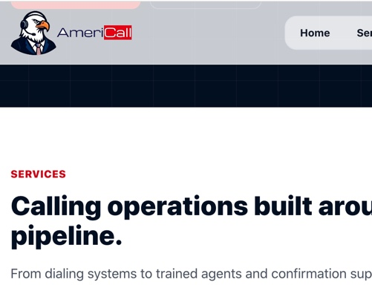
1. HOMEPAGE
Americall, Inc. Logo needs fixing IF you can clear the space in A and e in Americall. Looks odd on darker backgrounds.

Slide 2
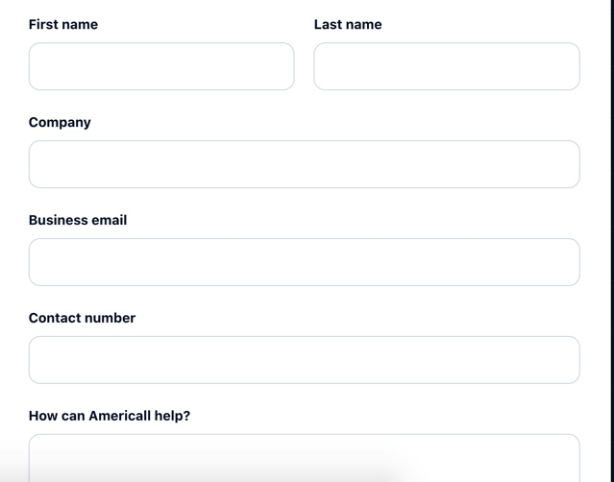
2. BOOK A DEMO FORM
Book A Demo Form 1.First Name, Last Name* 2.Designation 3.Company* 4. Business Email* 5. Contact Number* 6. Monthly Appointment Volume Dropdown a. Under 100 appointments/mo 100–500
b. appointments/mo 500–1,000
c. appointments/mo 1,000+/mo d. Not sure yet 7. How can Americall, Inc. Help?

Slide 3
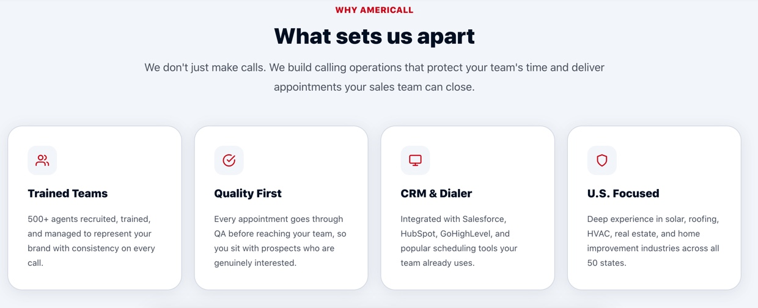
3. ABOUT SECTION

Slide 4
3. ABOUT SECTION (EXTENDED)
Smart Campaing Management
Trained Teams
Quality First
Industry Expertise
Every agent goes through a rigorous multi-stage recruitment and training process before handling a single call — ensuring only the most prepared, brand-aligned representatives reach your prospects.
Every call is monitored against your exact requirements. Our QA process captures performance data, surfaces coaching opportunities, and feeds directly back to agents — so standards tighten over time, not drift.
From scrubbed lead lists and connection-optimized DIDs to real-time agent oversight — we manage every layer of your campaign so your pipeline stays full and your team stays focused on closing.
Deep specialization across solar, roofing, HVAC, healthcare, and home improvement means your agents already understand your buyer's language before the first call is made.

Slide 5
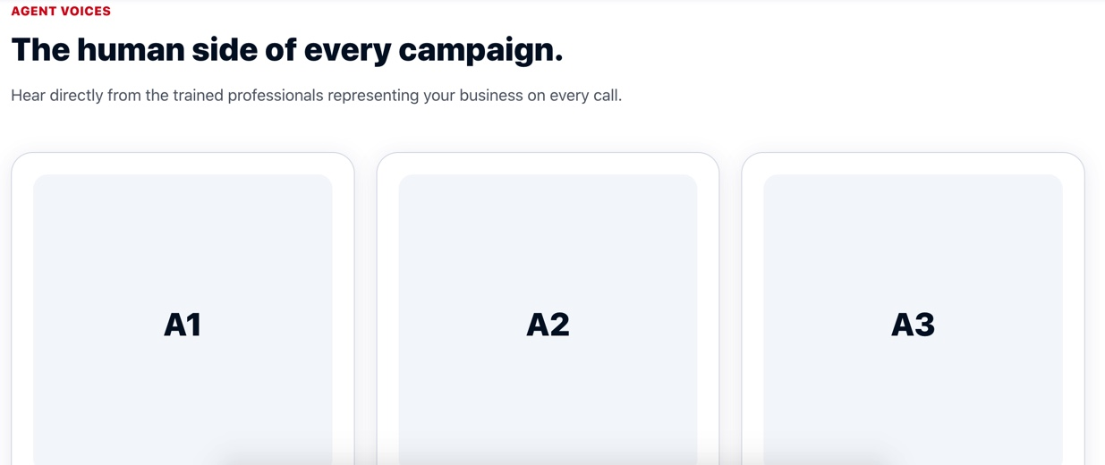
3. ABOUT SECTION (EXTENDED)
1. Bryan Tucker
4. Omar
2. Alex Mercer
5. Rezwan Chowdhury
3. Raiyan Dio Sarwar

